Slide 1
CHAPTER 9 Heredity and Evolution
PART – 1
HERIDITY

Slide 2
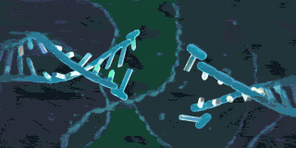
HERIDITY
The transfer of characters or traits from the parents to their off springs is called heredity.
Notes:
Heridity :-
The transfer of characters or traits from the parents to their off springs is called heredity.

Slide 3
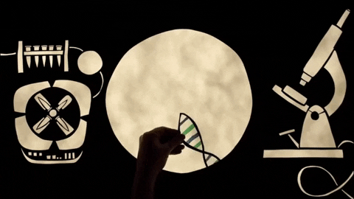
Accumulation of variations during reproduction
Off springs show minor variations when organisms reproduce.
Some variations are useful variations.
Some variations do not help the organism to adjust to the changes in the environment and they may die and become extinct.
Notes:
When organisms reproduce, the off springs show minor variations due to inaccuracies in DNA copying. These variations are less in asexual reproduction and more in sexual reproduction.
Some variations are useful variations and they help the organism to adjust to the changes in the environment. Some variations do not help the organism to adjust to the changes in the environment and they may die and become extinct.

Slide 4
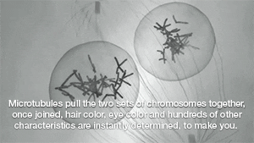
Rules for inheritance of characters (traits)
Characters are transferred through genes in the chromosomes.
The inheritance of characters is because both the father and mother contributes equal amount of genetic material to the child.
Gregor Johann Mendel conducted experiments with garden pea plants and determined the rules for the inheritance of traits.
Notes:
Characters are transferred through genes present in the DNA molecules in the chromosomes present in the nucleus of the cell.
The inheritance of characters is due to the fact that both the father and mother contributes equal amount of genetic material to the child. So for each trait there are two factors one from the father and one from the mother. Gregor Johann Mendel conducted experiments with garden
pea plants and determined the rules for the inheritance of traits.

Slide 5
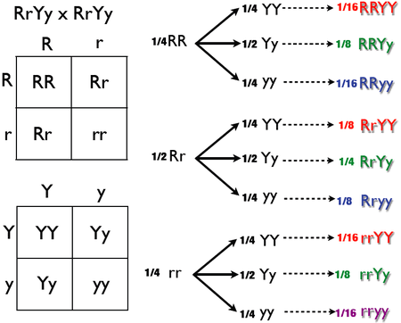
a)When plants having one pair of character (Eg:- tall and short plant) was crossed (Monohybrid cross)
Notes:
Mendel selected pea plants having one pair of character – a tall pea plant and a short pea plant.
First Generation (F1) : Cross pollination of pure tall (TT) and pure short (tt) pea plants all tall plants (Tt) in the first generation (F1 ).
When the first generation plants were self pollinated, he obtained tall and dwarf plants in the ratio 3:1 in the second generation. (F2 )
The ratio of pure tall (TT), hybrid tall (Tt) and pure dwarf (tt) was in the ratio 1:2:1
The trait that is expressed in the F1 generation is called the dominant trait and the trait that is supressed in the F1 is called the recessive trait.

Slide 6
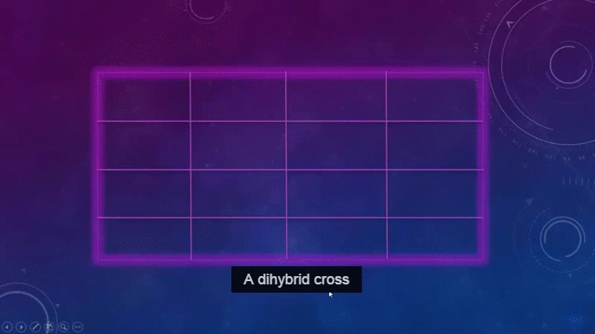
b)When plants having two pairs of characters (Eg:- shape and colour of seeds) were crossed (Dihybrid cross)
Notes:
Mendel selected pea plants having two pairs of characters – shape and colour of seed. He selected plants having round yellow seeds (RRYY) and wrinkled green seeds (rryy) and cross pollinated them. He obtained all plants with round yellow seeds (RrYy) in the F1 generation.
When these plants were self pollinated in the F2 generation out of 16 plants, 9 had round yellow (RrYy), 3 had round green (Rryy), 3 had wrinkled yellow (rrYy) and 1 had wrinkled green (rryy) seed. In the ratio 9:3:3:1.

Slide 7
Sex determination in human beings
Human beings have 23 pairs of chromosomes in the nucleus of the cell. Out of this two chromosomes are sex chromosomes X and Y.
The female has two X chromosomes (XX) and male has one X and one Y chromosome (XY).
Notes:
Human beings have 23 pairs of chromosomes in the nucleus of the cell. Out of this two chromosomes are sex chromosomes X and Y. The female has two X chromosomes (XX) and male has one X and one Y chromosome (XY). The sperms and eggs have one set of sex chromosomes. Some sperms have X chromosome and some have Y chromosome. All eggs have X chromosome.
If a sperm having X chromosome fuses with an egg having X chromosome the child will be a girl.
If a sperm having Y chromosome fuses with an egg having X chromosome the child will be a boy.

Slide 8
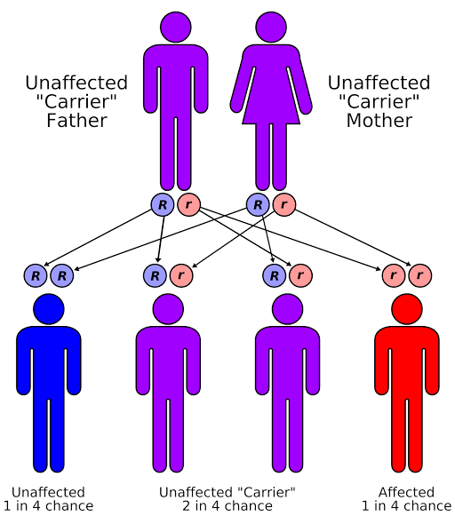
Notes:
We will study about EVOLUTION in the next presentation.

